Slide 1
SCRUM
Presented by
Dmitro Malikov

Slide 2
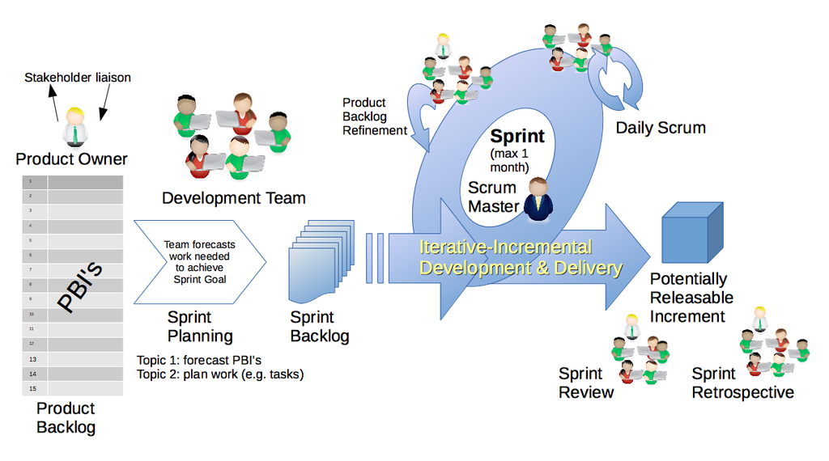
Scrum process
Notes:
A Sprint (or iteration) is the basic unit of development in Scrum. The Sprint is a timeboxed effort; that is, it is restricted to a specific duration. The duration is fixed in advance for each Sprint and is normally between two weeks and one month, with two weeks being the most common.
Each Sprint starts with a Sprint Planning event that aims to define a Sprint Backlog, identify the work for the Sprint, and make an estimated commitment for the Sprint goal.

Slide 3
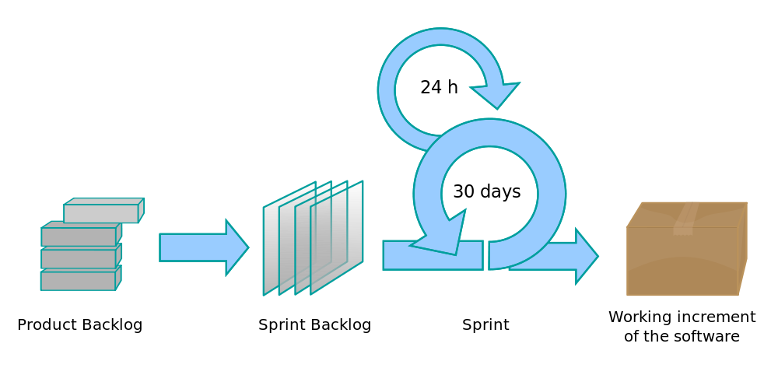
Scrum process
Notes:
Each Sprint ends with a Sprint Review and Sprint Retrospective, that reviews progress to show to stakeholders and identify lessons and improvements for the next Sprints.

Slide 4
Roles
Notes:
There are three core roles in the Scrum framework. These core roles are ideally colocated to deliver potentially shippable Product Increments. They represent the Scrum Team. Although other roles involved with product development may be encountered, Scrum does not define any team roles other than those described below.

Slide 5







Scrum team
SQL
User interaction
Product owner
Java
Team
Scrum Master
Notes:
The Product Owner represents the product's stakeholders and the voice of the customer; and is accountable for ensuring that the team delivers value to the business. The Product Owner writes customer-centric items (typically user stories), prioritizes them based on importance and dependencies, and adds them to the Product Backlog. Scrum Teams should have one Product Owner. This role should not be combined with that of the Scrum Master. The Product Owner should focus on the business side of product development and spend the majority of their time liaising with stakeholders and should not dictate how the team reaches a technical solution.
Scrum is facilitated by a Scrum Master, who is accountable for removing impediments to the ability of the team to deliver the product goals and deliverables. The Scrum Master is not a traditional team lead or project manager, but acts as a buffer between the team and any distracting influences. The Scrum Master ensures that the Scrum framework is followed. The Scrum Master helps to ensure the team follows the agreed processes in the Scrum framework, often facilitates key sessions, and encourages the team to improve. The role has also been referred to as a team facilitator or servant-leader to reinforce these dual perspectives.

Slide 6
Scrum team
Plan
Implement
Test
Demo
Inspect
&
Adapt
Notes:
The Development Team is responsible for delivering potentially shippable increments (PSIs) of product at the end of each Sprint (the Sprint goal). A team is made up of 3–9 individuals who do the actual work (analyse, design, develop, test, technical communication, document, etc.). Development Teams are cross-functional, with all of the skills as a team necessary to create a Product Increment. The Development Team in Scrum is self-organizing, even though there may be some interaction with a project management office.

Slide 7
Planning
JSP GUI
2 hours
Visual Design
4 hours
Returns
Test cases
3 hours
Service classes
2 hours
Sprint backlog
Team builds
Tasks
Code the UI
2 hours
Coupons
DAO + DBUnit
1 hours
Database design
1 hours
Service + JUnit
1 hours
Notes:
At the beginning of a Sprint, the Scrum Team holds a Sprint Planning event to:
Communicate the scope of work that is intended to be done during that Sprint
Select Product Backlog Items that can be completed in one Sprint
Prepare the Sprint Backlog that details the work needed to finish the selected Product Backlog Items
Time-boxed to a four-hour limit for a two-week Sprint (pro rata for other Sprint durations)
During the first half, the whole Scrum Team (Development Team, Scrum Master, and Product Owner) selects the Product Backlog Items might be achievable in that Sprint
During the second half, the Development Team decomposes the work items (tasks) required to deliver those Product Backlog Items; resulting in a confirmed Sprint Backlog
Some Product Backlog Items may be split or deprioritized if the identified work is not achievable in that Sprint
Once the Development Team prepares the Sprint Backlog, they commit (usually by voting) to deliver tasks within the Sprint.

Slide 8
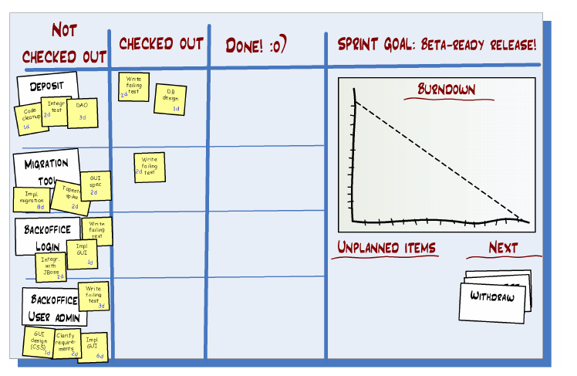
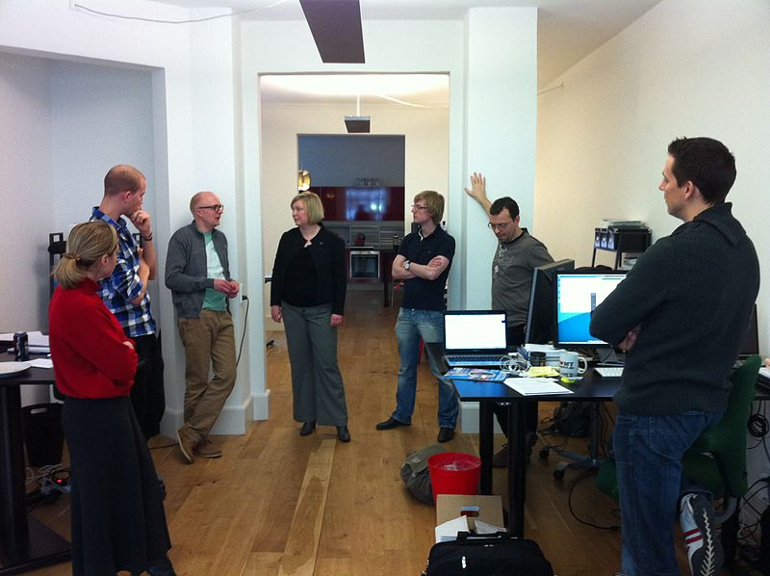
Daily Scrum
What did I do yesterday?
What will I do today?
Is there anything in my way?
Notes:
Each day during a Sprint, the team holds a Daily Scrum with specific guidelines:
All members of the Development Team come prepared. The Daily Scrum...
...starts precisely on time even if some Development Team members are missing
...should happen at the same time and place every day
...is limited (timeboxed) to fifteen minutes
Anyone is welcome, though normally only Scrum Team roles contribute.
During the Daily Scrum, each team-member answers three questions:
What did I do yesterday that helped the Development Team meet the Sprint goal?
What will I do today to help the Development Team meet the Sprint goal?
Do I see any impediment that prevents me or the Development Team from meeting the Sprint goal?
Any impediment (e.g., stumbling block, risk, issue, delayed dependency, assumption proved unfounded) identified in the Daily Scrum should be captured by the Scrum Master and displayed on the team's Scrum board or a shared Resolved/Owned/Accepted/Mitigated (ROAM) board, with an agreed person designated to working toward a resolution (outside of the Daily Scrum). No detailed discussions should happen during the Daily Scrum.

Slide 9
After the sprint
Sprint Review
Present what team accomplished.
Demo new features developed or underlying architecture.
Invite whole world.
Sprint Retrospective
Whole team discusses the results of last sprint
Start doing
Stop doing
Continue doing
Notes:
At the end of a Sprint, the team holds two events: the Sprint Review and the Sprint Retrospective.
At the Sprint Review, the team:
Reviews the work that was completed and the planned work that was not completed
Presents the completed work to the stakeholders (a.k.a. the demo)
Guidelines for Sprint Reviews:
Incomplete work cannot be demonstrated
The recommended duration is two hours for a two-week Sprint (pro-rata for other Sprint durations)
At the Sprint Retrospective, the team:
Reflects on the past Sprint
Identifies and agrees on continuous process improvement actions
Guidelines for Sprint Retrospectives:
Two main questions are asked in the Sprint Retrospective: What went well during the Sprint? What could be improved in the next Sprint?
The recommended duration is one-and-a-half hours for a two-week Sprint (pro-rata for other Sprint durations)
This event is facilitated by the Scrum Master

Slide 10
Artifacts

Slide 11
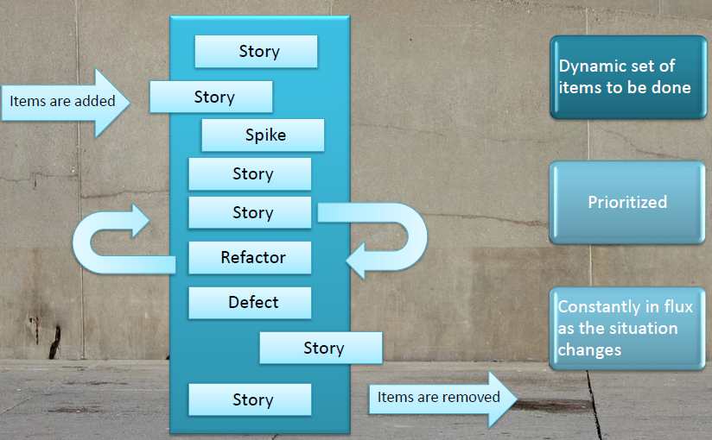
Product Backlog
Notes:
The Product Backlog comprises an ordered list of requirements that a Scrum Team maintains for a product. It consists of features, bug fixes, non-functional requirements, etc.—whatever must be done to successfully deliver a viable product. The Product Owner orders the Product Backlog Items (PBIs) based on considerations such as risk, business value, dependencies, and date needed.
Items added to a backlog are commonly written in story format. The Product Backlog is what will be delivered, ordered into the sequence in which it should be delivered. It is visible to everyone but may only be changed with the consent of the Product Owner, who is ultimately responsible for ordering Product Backlog Items for the Development Team to choose.

Slide 12
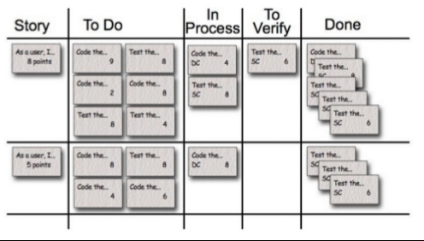
Sprint Backlog
Notes:
The Sprint Backlog is the list of work the Development Team must address during the next Sprint. The list is derived by the Scrum Team progressively selecting Product Backlog Items in priority order from the top of the Product Backlog until they feel they have enough work to fill the Sprint. The Development Team should keep in mind its past performance assessing its capacity for the new Sprint, and use this as a guide line of how much 'effort' they can complete.

Slide 13
Sprint burn-down chart
Notes:
The Sprint burn-down chart is a public displayed chart showing remaining work in the Sprint Backlog. Updated every day, it gives a simple view of the Sprint progress. It also provides quick visualizations for reference. The horizontal axis of the Sprint burn-down chart shows the days in a Sprint, while the vertical axis shows the amount of work remaining each day

Slide 14
Product Increment
The increment (or potentially shippable increment, PSI) is the sum of all the Product Backlog Items completed during a Sprint, integrated with the work of all previous Sprints.
At the end of a Sprint, the increment must be complete, according to the Scrum Team's definition of done (DoD), fully functioning, and in a usable condition regardless of whether the Product Owner decides to actually release it.
Notes:
The increment (or potentially shippable increment, PSI) is the sum of all the Product Backlog Items completed during a Sprint, integrated with the work of all previous Sprints.
At the end of a Sprint, the increment must be complete, according to the Scrum Team's definition of done (DoD), fully functioning, and in a usable condition regardless of whether the Product Owner decides to actually release it.

